Slide 1
Thread vs Process
System Call
Dr. Manmath N. Sahoo
Dept. of CSE, NIT Rourkela

Slide 2
Threads Vs Processes
for(i=0;i<100000;i++)
{
receive data from i/p device //RcvData()
send data on communication link //SendonLink()
}
If communication link is not free then the process will halt in line#4. Even though i/p device is free, it can be used.
In line#3, if user has not specified any input then communication link may be underutilized.
If there is no other process available, then CPU can’t make a context switch even (at line#3)

Slide 3
Threads Vs Processes
Solution
Consider RcvData() and SendonLink() to be two different entities
RcvData(), on data availability, will put data in a queue
SendonLink(), on link availability, will send data from the queue
Whoever is free, can execute on CPU
RcvData() and SendonLink() entities can be implemented as processes or Threads

Slide 4
Threads Vs Processes
Threads are the unit of execution in a process.
A thread shares address space with it’s parent.
Per Thread items
Thread ID – Unique identifier
Program Counter – which instruc­tion to execute next
Registers – for computation
Stack – contains the execution history
State – thread state
Notes:
Thread Example:
Auto saving on word while typing
Printing a large word document and typing

Slide 5
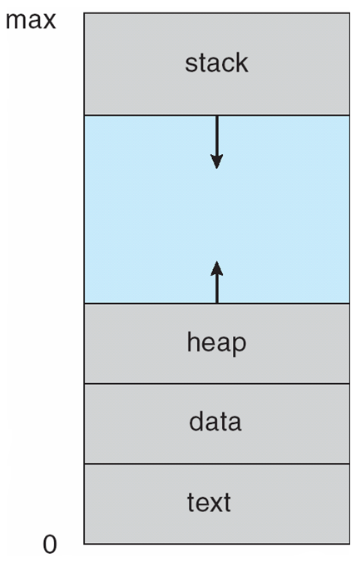
address space of a process

Slide 6
Single and Multithreaded Processes

Slide 7
Threads Vs Processes
Threads share the address space of the process that created it; processes have their own address space.
Threads have direct access to the data segment of its process; processes have their own copy of the data segment of the parent process.
Threads can directly communicate with other threads of its process; processes must use interprocess communication to communicate with sibling processes.
Threads have almost no overhead; processes have considerable overhead.
New threads are easily created; new processes require duplication of the parent process.
It is a light weight process and faster

Slide 8
Thread: Programmer’s View
void fn1(int arg0, int arg1, …) {…}
main() {
…
tid = CreateThread(fn1, arg0, arg1, …);
…
}
At the point CreateThread is called, execution continues in parent thread in main function, and execution starts at fn1 in the child thread, both in parallel

Slide 9
Thread Benefits
Responsiveness – may allow continued execution if part of process is blocked, especially important for user interfaces
Resource Sharing – threads share resources of process, easier than shared memory or message passing
Economy – cheaper than process creation, thread switching lower overhead than context switching
Scalability – threads can take advantage of multiprocessor architectures

Slide 10
How Thread Can Help? – Example 1
Consider the following code fragment
for(k = 0; k < n; k++)
a[k] = b[k] * c[k] + d[k] * e[k];
Rewrite this code fragment as:
CreateThread(fn, 0, n/2);
CreateThread(fn, n/2, n);
fn(l, m) {
for(k = l; k < m; k++)
a[k] = b[k] * c[k] + d[k] * e[k];
}
What did we gain?

Slide 11
System Call
A request by an active process to the Kernel for a service
Defines the interface between the user and the OS
The process switches to Kernel mode from user mode, during a system call
Preemptive vs. non-preemptive kernel
NonPreemptive: Linux 2.4 Kernel
Preemptive: Linux 2.6 Kernel

Slide 12
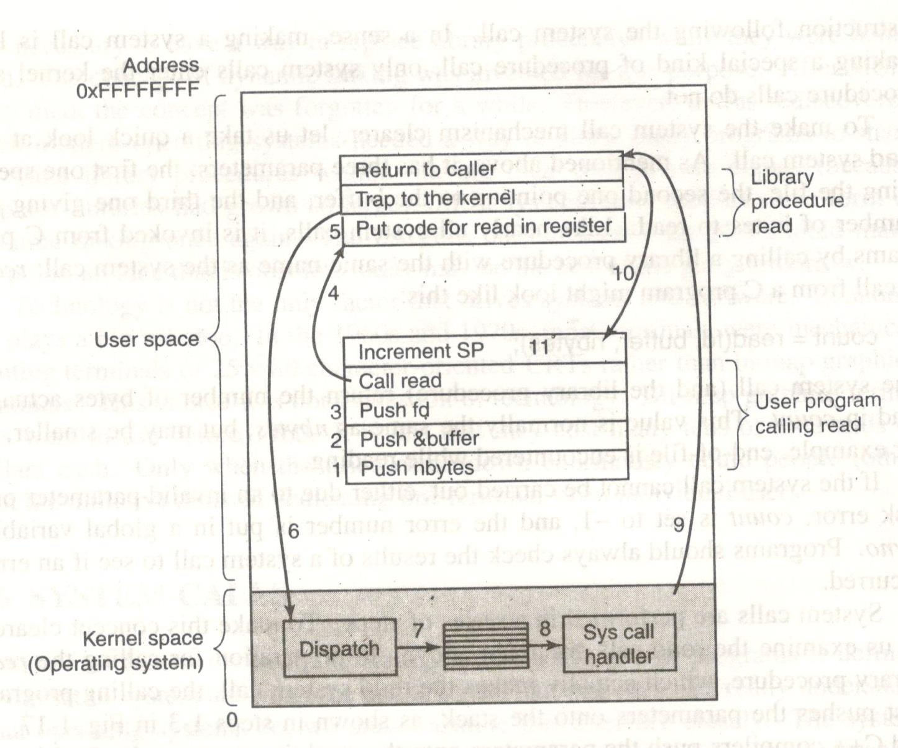
read system call – read(fd,&buffer,nbytes)

